Slide 1

Marketing Research Analysis Sarang Manohar PGP-DSBA Jan’ 21
Submitted on Jan’ 21 2023

Slide 2
Agenda
Problem Statement
Exploratory Data Analysis
Market Basket Analysis using Python(Apriori algorithm from apyori library)**
Inference & Recommendations
** KNIME threw an error while configuring Association rule learner node. Hence, used Python code instead

Slide 3
Problem Statement
The data set provided to you is the data set of a Café Chain for one of its restaurants. Do a thorough analysis of the data and come up with the following analysis.
The owner of the restaurant wants you to use this data to come up with a set of recommendations that can help his Café Chain increase its revenues. He is able to provide you with a data set for POS (point of sale data) for one of his chains.
Exploratory Analysis
Exploratory Analysis of data & an executive summary (in PPT) of your top findings, supported by graphs
What kind of trends do you notice in terms of consumer behaviour over different times of the day and different days of the week? Can you give concrete recommendations based on the same?
Are there certain menu items that can be taken off the menu?
Are there trends across months that you are able to notice?
Menu Analysis
Identify the most popular combos that can be suggested to the restaurant chain after a thorough analysis of the most commonly occurring sets of menu items in the customer orders. The restaurant doesn’t have any combo meals. Can you suggest the best combo meals?
Use of Market Basket Analysis (Association Rules)
Write Something about the association rule and its relevance in this case
Add KNIME workflow Image or Python package used
Write about threshold values of Support and Confidence
Associations Identified
Put the associations in a tabular manner
Explain about support, confidence, & lift values that are calculated
The suggestion of Possible Combos with Lucrative Offers
Write recommendations
Make discount offers or combos ( or buy two get one free) based on the associations and your experience

Slide 4
Exploratory Data Analysis

Slide 5
About Data
There are 145830 records and 10 columns in the provided data
There are no NULLs/blank fields in the data
There are 680 records with 634 unique bill numbers that are duplicate. Post clean up we were left with 145150 non duplicate records
There are 69982 unique bill numbers in the data
The data is exactly for 365 days i.e. 1 year starting April 1st 2010 and ending on March 31st 2011
There are 580 unique items on the menu spread across 9 categories

Slide 6
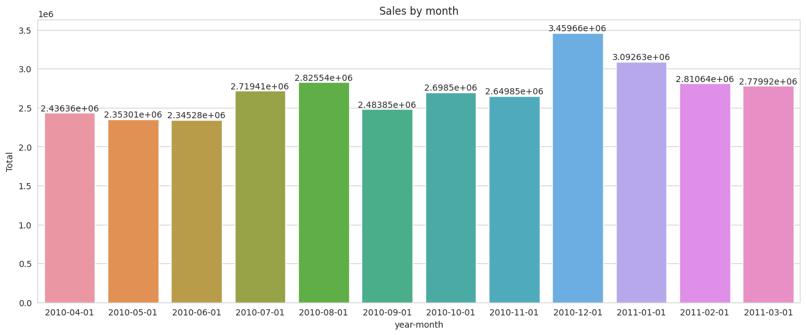
Sales trend by month
December had the maximum sales in monetary terms which aligns vacation/holiday seasons
There is a slight dip in the sales for month of June, but overall there is a month over month up-trend in sales through the year
Most sales
Least sales

Slide 7
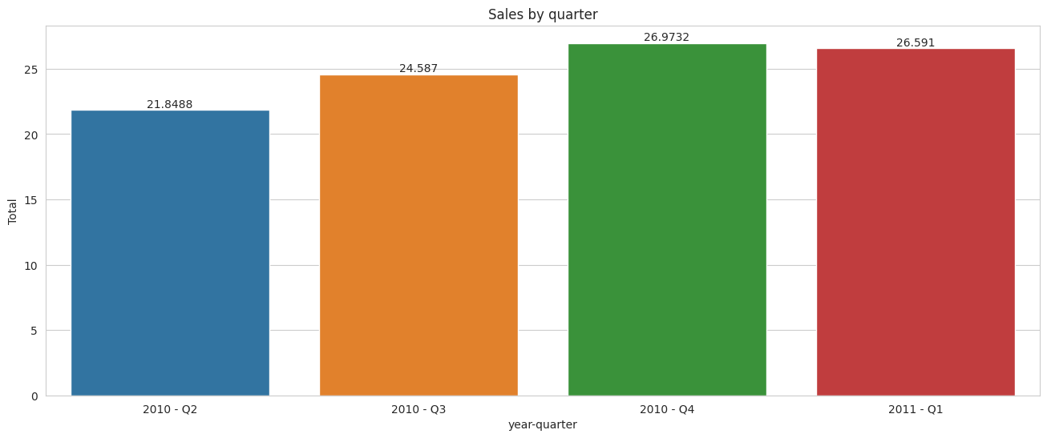
Sales trend by quarter
There is a consistent QoQ growth in sales with a very slight dip from Q4 2010 to Q1 2011
Q4 2010 and Q1 2011 together i.e. the second half of financial year contributed to 53.56% of total annual sales(FY)

Slide 8
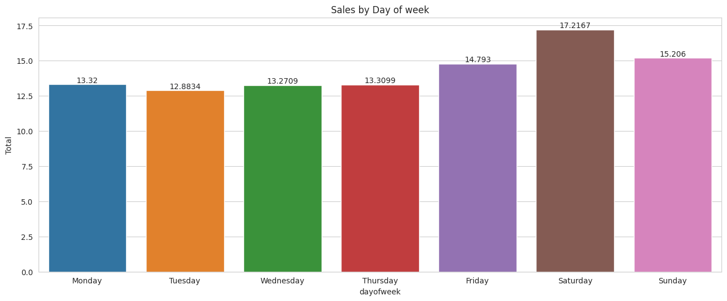
Sales trend by days of the week
During weekdays, the sales at the restaurant are fairly consistent
On weekends, including Fridays the sales is much higher than rest of the weekend

Slide 9
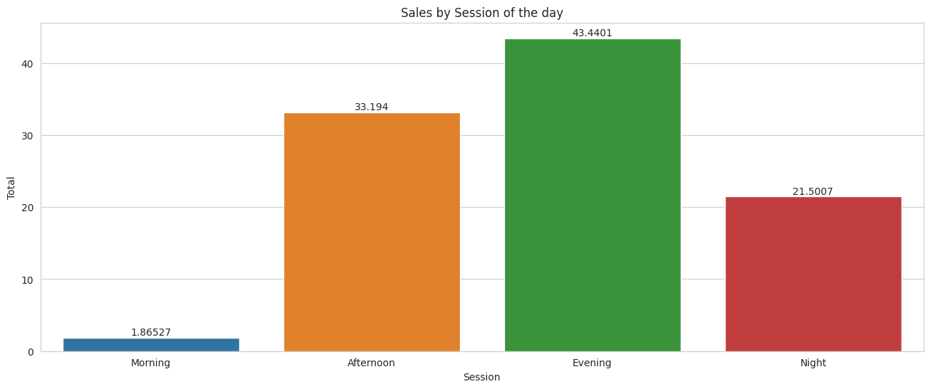
Sales trend by time of the day
Mornings have very low volume of sales
Most sales are in the evening, followed by afternoon and then night sessions
Hours | Session
6 – 11 | Morning
12 – 17 | Afternoon
18 – 22 | Evening
23 – 5 | Night

Slide 10
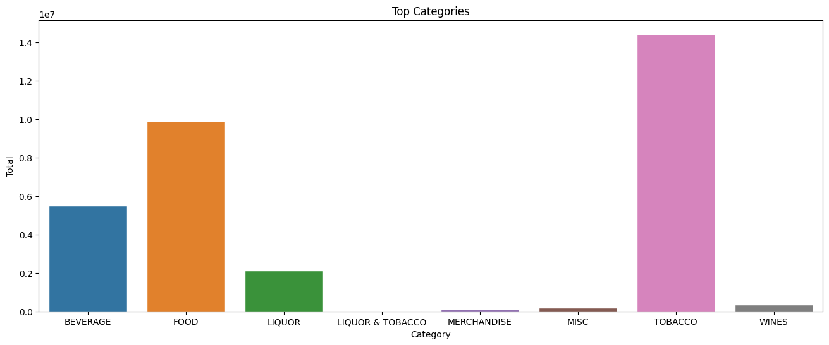
Sales by product categories
Majority of the sales revenue was concentrated with 3 product categories i.e. Food, beverage and tobacco
Merchandise, Wines and Miscellaneous items had much smaller value of sales

Slide 11
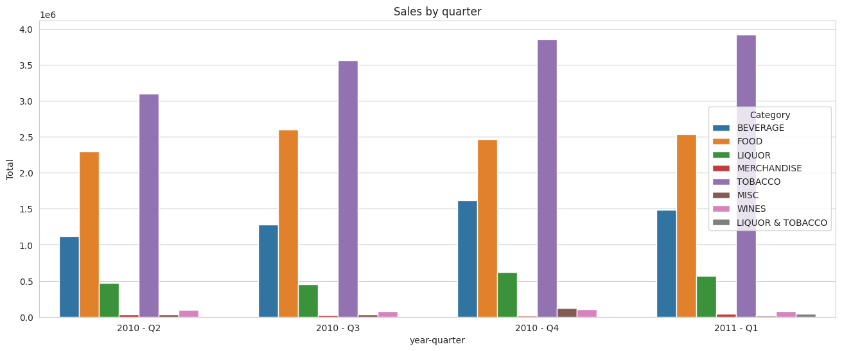
Sales break-down by product categories and quarter
The sales by product category remained more or less in similar proportion throughout the year
Miscellaneous product sales saw a significant jump in Q4 2010, probably because of holiday season

Slide 12
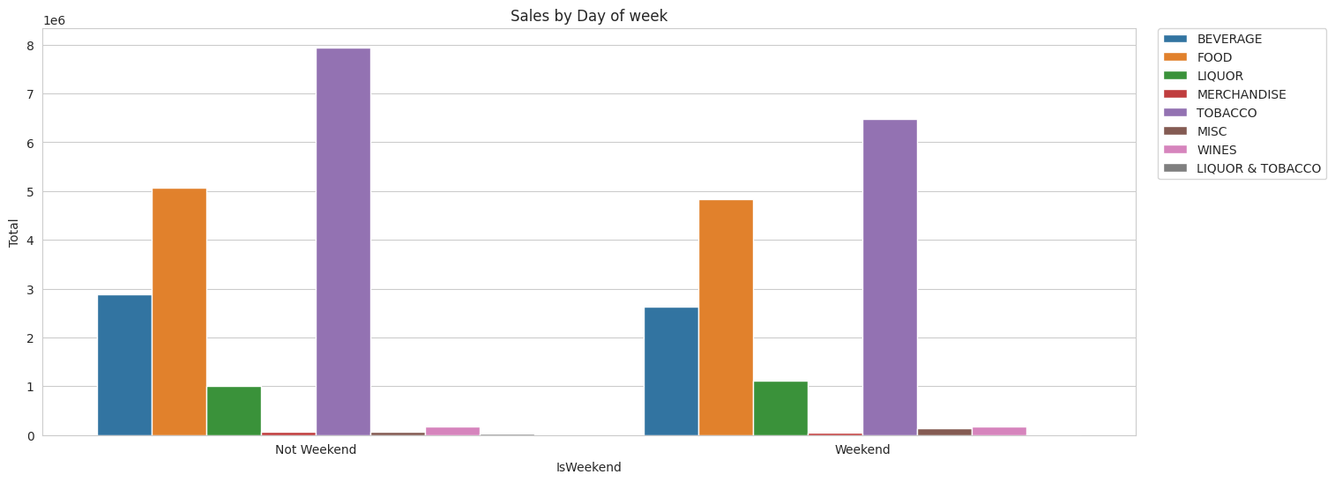
Sales break-down by product categories and quarter
The sales by product category remained more or less in similar proportion irrespective of the day of the week it is
Sales distribution by category is similar

Slide 13
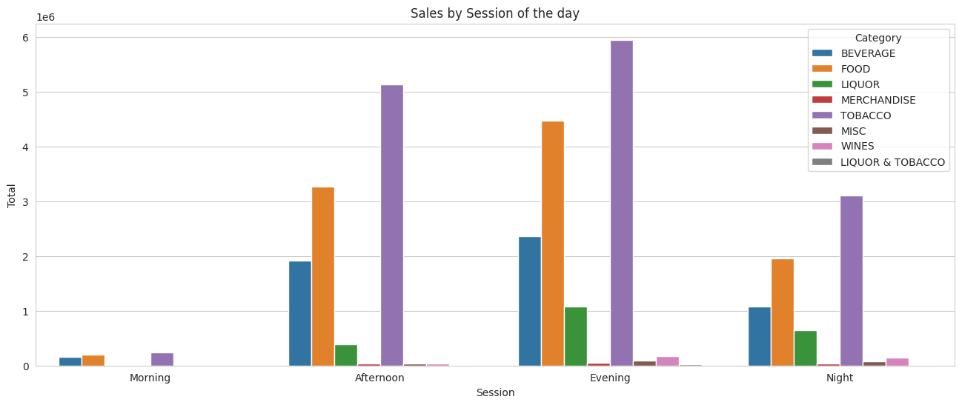
Sales break-down by product categories and quarter
The sales by product category remained more or less in similar proportion between afternoon and evening
Morning and Night have different sales patterns when broken down at product category level. For example in mornings the sales of Liquor is almost negligible

Slide 14
EDA observations
The business at the restaurant is growing consistently QoQ
The unit is into sales of variety of products ranging from food and beverages to liquor, tobacco and even merchandise
More than 90% of sales is attributed to 3 product categories, that are tobacco(44%), food(30%) & beverages(17%)
Merchandise, miscellaneous and wines add up to only 2% of the overall sales
The sales patterns seems cyclical
At day level, afternoon and evenings are much busier than late nights or mornings
At week level, the weekends have more sales than weekdays
At month level, December and January seems to drive on an average better sales than rest of the months

Slide 15
Recommendations to improve operational efficiencies**
Hire staff in shifts based on customer foot-fall trends
Majority of support staff should be deployed during afternoon and evening hours
During night hours the number of staffs should be half of those deployed in evening hours
Morning hours see very less foot-fall so the maximum number of staffs should be decided accordingly
During weekends the number of staffs should be bumped to ensure the service time are kept to minimal
Inventory management
Since, merchandise constitutes a very small of overall sales, the inventory for it should be managed according to cyclicity of sales patterns. For example, open merchandise kiosks during a couple of weeks before holiday season starts
** These are optional recommendations to be considered if the client finds value in them

Slide 16
Market Basket Analysis

Slide 17
Market Basket Analysis
Market Basket Analysis is a technique used in retail to identify associations or relationships between items in a customer's shopping basket or cart. It uses transactional data to identify which items are frequently purchased together, and can be used to inform decisions about product placement, promotions, and other marketing strategies. The goal of market basket analysis is to uncover patterns in customer behaviour that can be used to increase sales and improve customer satisfaction.
Support: the percentage of transactions in which a specific item or group of items appears.
Confidence: the percentage of transactions in which a specific item or group of items appears, given that another specific item or group of items appears.
Lift: the ratio of the observed support to the expected support if the items were independent.

Slide 18
Market Basket Analysis – Flow chart to explain python code
Raw data
Data clean-up
For e.g. remove duplicates
Remove leading and trailing blanks spaces from Item_Desc
Flatten the Item_Desc by Bill_Number and store in list
Analyze the results
Pass the data through “apyori” model to create association rules
Create a dataframe to store the list against the Bill_Number
Are the results satisfactory?
No
Update min support and confidence threshold
Yes
Create inferences
Interpret the results

Slide 19
Approach to fine tune the association rules
With threshold values; support<0.00011 and confidence<0.25, following is approach
A lot of rules had typically the side items as the base item. This may be due to how data was captured in raw format – We would avoid the rules with only one base item
Filter for minimum confidence of at least 0.5
With the above filters we were able to reduce the rules from 266 to 48
Further we can observe that in these 48 rules the lift ranges from 4.7 to 379.75. Hence, to further find the most valuable rules we apply a filter of Lift > 10
With the above filters we are left with 30 rules which we will discuss in detail in coming slides

Slide 20
Definitions based on conditions shared in previous slide

Slide 21
Interpreting rule 47 & rule 71
Rule 47:
Confidence of 70% who bought Beer Hookah and 3 Red Bull also ordered Veg. Pasta Alferdo
A very high lift of 379.75, which suggests that a veg. Pasta Alferdo will get ordered if someone orders Beer Hookah and Red Bull
Rule 71:
Confidence of 70% who bought Great Lakes Shake also ordered Lemon Infused Char Grilled Veg with Herb Roasted Chicken**
A very high lift of 119.48, which suggests that a Lemon Infused Char Grilled Veg with Herb Roasted Chicken** will get ordered if someone orders Great Lakes Shake
**Taking the liberty to consider Lemon infused Char Grilled Veg with Herb Roast chicken as the former should be the main item and later as the add-on/optional item

Slide 22
Interpreting rule 72 & rule 62
Rule 72:
Confidence of 69.2% who bought Nirvana Hookah Single also ordered Lemon Infused Char Grilled Veg with Herb Roasted Chicken **
A very high lift of 118.17, which suggests that a Lemon Infused Char Grilled Veg with Herb Roasted Chicken** will get ordered if someone orders Nirvana Hookah Single
**Taking the liberty to consider Lemon infused Char Grilled Veg with Herb Roast chicken as the former should be the main item and later as the add-on/optional item
Rule 62:
Confidence of 77.8% who bought B.M.T. Panini also ordered Caffe Latte with Hazelnut flavour ^^
A very high lift of 25.98, which suggests that a Caffe Latte with Hazelnut flavour ^^ will get ordered if someone orders B.M.T. Panini
^^Taking the liberty to consider Caffe Latte with Hazelnut flavour as the former should be the main item and later as the add-on/optional item

Slide 23
Interpreting rule 115 & rule 65
Rule 115:
Confidence of 68.75% who bought Rabat Hookah & Meze Platter also ordered Berry Blast
A very high lift of 23.69, which suggests that a Berry Blast will get ordered if someone orders Rabat Hookah & Meze Platter
Rule 65:
Confidence of 66.67% who bought Nirvana Hookah Single also ordered Caffe Latte with Hazelnut flavour ^^
A very high lift of 22.27, which suggests that a Caffe Latte with Hazelnut flavour ^^ will get ordered if someone orders Nirvana Hookah Single
^^Taking the liberty to consider Caffe Latte with Hazelnut flavour as the former should be the main item and later as the add-on/optional item

Slide 24
Rules with 100% confidence
Rule 258:
Confidence of 100% who bought Great Lakes Shake, Red Bull 2+1, Philly Cream Cheese & Chilly Pan also ordered Sambuca
A very high lift of 15.82, which suggests that a Sambuca will get ordered if someone orders Great Lakes Shake, Red Bull 2+1, Philly Cream Cheese & Chilly Pan
Rule 252:
Confidence of 100% who bought Great Lakes Shake, Red Bull 2+1, Maggi Noodles Arrabiata also ordered Sambuca
A very high lift of 15.82, which suggests that a Sambuca will get ordered if someone orders Great Lakes Shake, Red Bull 2+1, Maggi Noodles Arrabiata

Slide 25
Recommendations
Great Lakes Shake appears to be popular beverage and can be put in combo with other food items
B.M.T. Panini & Red Bull appears to be popular combination and the restaurant should offer interesting combo/discount deals
Sambuca and Qua Mineral Water can be combined as combo offer
Offer buy 3 get 1 free for Red Bull
Introduce Happy Hours in the morning session, where all the food and beverages items are at certain discounted rate with intension to increase the foot-fall
Explore the possibility to have dedicated themes on Weekdays, for example: Ladies only Wednesdays, Karaoke Thursdays, etc. with intension to increase the foot-fall on weekdays

Slide 26
Thank You

